Slide 1
Session 1

Slide 2
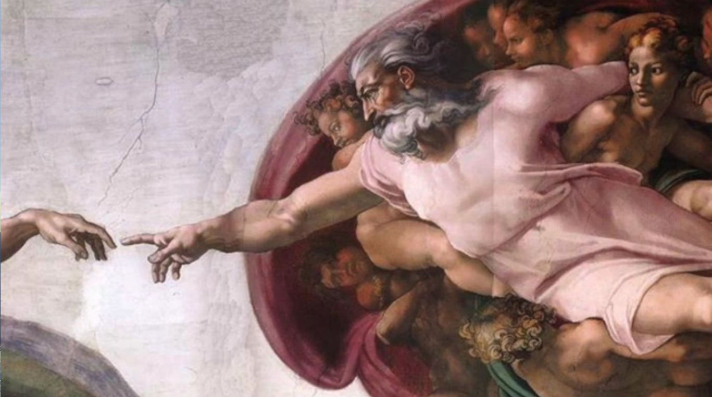
LUTHERAN HOUR MINISTRIES

Slide 3
INTRODUCTIONS
Welcome!
We are glad you are here!
If you could ask God a question, what would it be?
In the past, how have you learned about God?

Slide 4
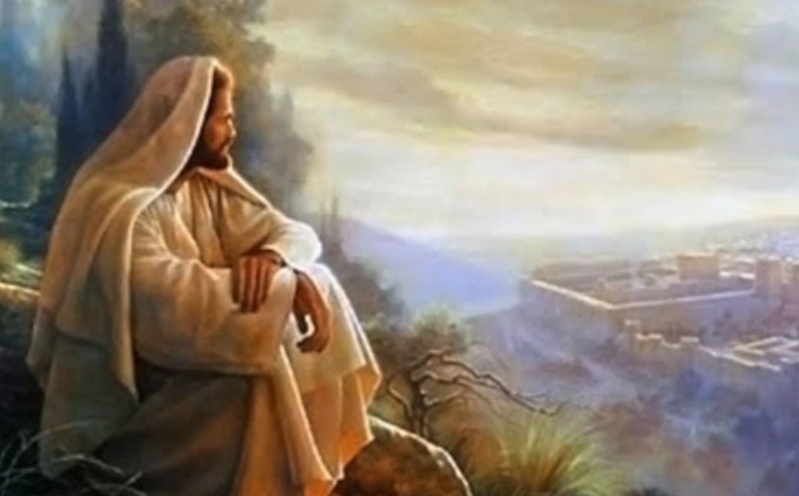
Why Jesus?
Questions or Comments?
Click to watch video.

Slide 5
The Problem
God’s standard (the Law) is so high that we can’t keep it.
“Now we know that whatever the Law says it speaks to those who are under the Law, so that every mouth may be stopped, and the whole world may be held accountable to God. For by works of the Law no human being will be justified in His sight, since through the Law comes knowledge of sin.”
Romans 3:19-20

Slide 6
God’s Solution
The Good News (the Gospel) is that Jesus makes a way to heaven for us.
“For God so loved the world, that He gave His only Son, that whoever believes in Him should not perish but have eternal life. For God did not send His Son into the world to condemn the world, but in order that the world might be saved through Him.”
John 3:16-17

Slide 7
God’s Solution
Our relationship with God is restored as a gift (grace).
“For by grace you have been saved through faith. And this is not your own doing; it is the gift of God, not a result of works, so that no one may boast.”
Ephesians 2:8-9

Slide 8
DISCUSSION
According to the Bible, how far has God lowered the bar regarding what we must do if we are to earn our way to heaven?
Christianity teaches that Jesus has done everything necessary for us to go to heaven. It doesn’t depend on how good we are. What questions does that raise in your mind? Is that fair?

Slide 9
Session 2

Slide 10
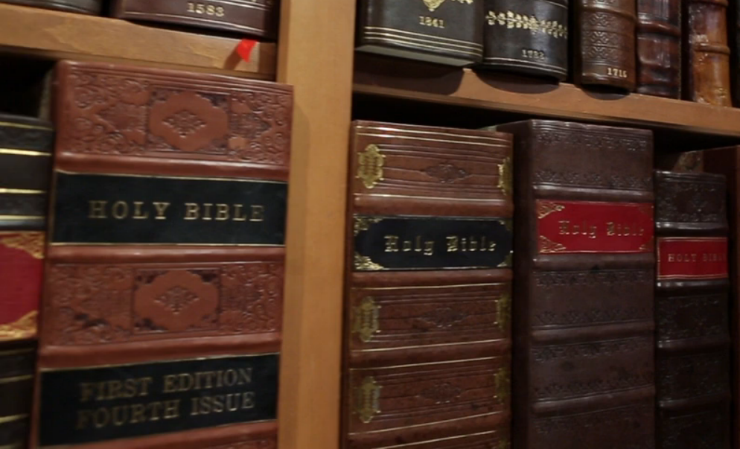
Why the Bible?
Questions or Comments?
Click to watch video.

Slide 11
The Purpose
The purpose of the Bible is to reveal God’s way to heaven through Jesus.
“Now Jesus did many other signs in the presence of the disciples, which are not written in this book; but these are written so that you may believe that Jesus is the Christ, the Son of God, and that by believing you may have life in His Name.”
John 20:30-31

Slide 12
The Source
The Bible is from God and is God’s Word to us.
“All Scripture is breathed out by God and profitable for teaching, for reproof, for correction, and for training in righteousness, that the man of God may be complete, equipped for every good work.”
2 Timothy 3:16-17

Slide 13
The Source
However, God spoke through men so that they wrote exactly what He wanted (no errors).
“For no prophecy was ever produced by the will of man, but men spoke from God as they were carried along by the Holy Spirit.”
2 Peter 1:21

Slide 14
Law and Gospel
A key to understanding the Bible is how it speaks in terms of Law and Gospel.
“For the Law was given through Moses; grace and truth came through Jesus Christ.”
John 1:17
See GodConnects website, Question 2.11, for more explanation.

Slide 15
Law
Gospel
The Law shows our sin and threatens God’s punishment. It requires perfection.
“For the wages of sin is death ...” Romans 6:23a
The Gospel is the Good News that God forgives us in spite of our sins and without our good works.
“… but the free gift of God is eternal life in Christ Jesus our Lord.” Romans 6:23b

Slide 16
DISCUSSION
How does it affect your view of the Bible when you realize God worked through human writers?
What is the implication for your life that the Bible is God’s Word?
Is there something about the Bible with which you struggle?

Slide 17
Session 3

Slide 18
God’s Law
Questions or Comments?
Click to watch video
Click to watch video.

Slide 19
God’s Law
God’s Law, as summarized by the Ten Command-ments, tells us what God’s will is. When we break any commandment (sin), we rightfully deserve God’s punishment.
“… the soul who sins shall die.”
Ezekiel 18:4b

Slide 20
God’s Law
However, Christ took the punishment for our sin on our behalf, so that we are freed from its consequence.
“And you … God made alive together with Him, having forgiven us all our trespasses, by canceling the record of debt that stood against us with its legal demands. This He set aside, nailing it to the cross.” Colossians 2:13-14

Slide 21
Kinds of Sins
Original sin – is the sin with which all people are born from their parents. Original sin means our relationship with God is broken from the beginning.
“Surely I was sinful at birth, sinful from the time my mother conceived me.”
Psalm 51:5 (NIV)

Slide 22
Kinds of Sins
Actual sin – They are violations of God’s Law by our action or inaction.
Sins of commission - doing something wrong
Sins of omission - not doing the good that is required

Slide 23
Purpose of the Law
Curb
Mirror
Guide
The Law controls the violent outburst of sin in the world. See Romans 13:3.
The most important purpose is to reveal our sinfulness so that we see our need for forgiveness. See Romans 7:7b.
The Law tells Christians what God’s will is for their lives. See Psalms 119:105.

Slide 24
The Ten Commandments
The First Table – Our relationship with God
First: You shall have no other gods. (Question 3.10)
Second: You shall not misuse the Name of the Lord your God. (Question 3.11)
Third: Remember the Sabbath day by keeping it holy. (Question 3.12)
Notes:
Questions refer to the GodConnects Web site, www.lhm.org/GodConnects.

Slide 25
The Ten Commandments
The Second Table – Our relationships with each other
Fourth: Honor your father and your mother. (Question 3.13)
Fifth: You shall not murder. (Question 3.14)
Sixth: You shall not commit adultery. (Question 3.15)
Seventh: You shall not steal. (Question 3.16)
Eighth: You shall not give false testimony against your neighbor.
Ninth and Tenth: You shall not covet ... (Question 3.18-19)

Slide 26
DISCUSSION
Why is it hard to accept that newborn babies (and even babies in the womb) are sinners who need God's forgiveness?
The U.S. was outraged when a teenager who killed four people in a drunk driving accident did not receive jail time from the judge, due to the so-called Affluenza Defense. The judge was fired. Why wouldn’t we expect God, as the perfect judge, not to justly punish sin?

Slide 27
DISCUSSION
When we think of sin, why do we tend to focus on the bad things we have done and said, more than the thoughts and desires of our minds and hearts?

Slide 28
Session 4

Slide 29
The Nature of God
Questions or Comments?
Click to watch video.

Slide 30
God’s Nature
The true God is the Triune God, that is, one God in three Persons, the Father, the Son (Jesus), and the Holy Spirit, called the Trinity.
“… The Lord our God is one.”
Deuteronomy 6:4b
(Jesus said)"Go therefore and make disciples of all nations, baptizing them in the Name of the Father and of the Son and of the Holy Spirit."
Matthew 28:19

Slide 31
God’s Attributes
God is a Spirit who has existed for all eternity. He is …
All-knowing John 21:17 | All-powerful Matthew 19:26 | Present everywhere Jeremiah 23:24 | Unchanging James 1:17
Faithful 2 Timothy 2:13 | Holy (sinless) Leviticus 19:2 | Forgiving Psalm 86:15 | Just Deuteronomy 32:4
God is love! 1 John 4:16

Slide 32
The Work of the Trinity
Generally, we speak of
the Father as the Creator, who made everything;
the Son (Jesus) as the Redeemer, who bought us from sin by the cross, and
the Holy Spirit as the Sanctifier, who makes us holy.

Slide 33
Creation
The Bible records the universe and everything in it was created by God, out of nothing, in six days.
“For in six days the Lord made heaven and earth, the seas, and all that is in them, and rested on the seventh day. Therefore the Lord blessed the Sabbath day and made it holy.” Exodus 20:11

Slide 34
Unique Creation of Man
Of everything that God created, the most special was mankind, created in the image of God.
“Then God said, ‘Let Us make man in Our image, after Our likeness. And let them have dominion over the fish of the sea and over the birds of the heavens and over the livestock and over all the earth and over every creeping thing that creeps on the earth.’”
Genesis 1:28

Slide 35
Creation of Angels
God also created angels. They are spirit beings without physical bodies.
They are numerous and powerful (see Daniel 7:10).
They serve as God’s messengers.
“And (Gabriel) came to (Mary) and said, ‘Greetings, O favored one, the Lord is with you!’” Luke 1:28
They protect God’s people.
“For He will command His angels concerning you to guard you in all your ways.” Psalm 91:11

Slide 36
Creation and Fall of the Devil and Demons
The devil (Satan) is an angel who rebelled against God and works against His purpose and threatens His people.
“Put on the whole armor of God, that you may be able to stand against the schemes of the devil.” Ephesians 6:11
Demons are other angels that rebelled with Satan.
“Now war arose in heaven, Michael and his angels fighting against the dragon (the devil). And the dragon and his angels fought back, but he was defeated, and there was no longer any place for them in heaven.” Revelation 12:7-8

Slide 37
DISCUSSION
How do we know God exists?
What are ways you have heard the Trinity explained?
If God is active in the world, why do bad things happen?
God gave man authority over creation. How are we doing in caring for it?

Slide 38
Session 5

Slide 39
Who is Jesus Christ?
Q Questions or Comments?
Click to watch video.

Slide 40
Who is Jesus Christ?
Jesus is fully God, the second Person of the Trinity (the Son), who also became fully man but without sin.
“In the beginning was the Word, and the Word was with God, and the Word was God … The Word became flesh and made His dwelling among us.”
John 1:1, 14a

Slide 41
Why a Man?
Jesus had to become a human in order that He could keep God’s Law on our behalf to be our Substitute.
“God made Him who had no sin to be sin for us, so that in Him we might become the righteousness of God.”
2 Corinthians 5:21

Slide 42
Why still God?
Jesus had to be God in order that His sacrifice would be sufficient to pay for the sins of the world.
“He is the atoning sacrifice for our sins, and not only for ours but also for the sins of the whole world.”
1 John 2:2

Slide 43
The Reason for Jesus
Jesus then died on the cross as a sacrifice to restore our relationship with God. His death has paid the price for our sin.
“He was pierced for our transgressions; He was crushed for our iniquities; upon Him was the chastisement that brought us peace, and with His wounds we are healed.”
Isaiah 53:5
“For by grace you have been saved through faith. And this is not your own doing; it is the gift of God, not a result of works, so that no one may boast.”
Ephesians 2:8-9

Slide 44
Two States of Jesus
While on earth Jesus lived in a state of “humiliation.” He laid aside His divine power. Now He is in a state of exaltation.
Read Philippians 2:5-11.

Slide 45
Jesus’ Life
Exaltation
Humiliation
Sits at the right hand of God
He ascended into heaven
Conceived by the Holy Spirit
The third day He rose again from the dead
Born of the Virgin Mary
Suffered under Pontius Pilate
He descended into hell
Was crucified, died, was buried
… from the Apostles’ Creed

Slide 46
Three Offices
Christ (meaning “anointed” or “chosen”) is our
Prophet : He speaks to us on God’s behalf:
“I have revealed You to those whom You gave Me.”
John 17:6a
Priest: He intercedes before God on our behalf:
“I pray for them ... for they are Yours.” John 17:9
King: He governs and protects us on earth and into eternity:
“All authority in heaven and earth has been given to Me.” Matthew 28:18b

Slide 47
DISCUSSION
What new concept about Jesus do you find the most difficult to understand? Believe?
If God has appointed Jesus to speak to us on His behalf, it’s because He wants to communicate with us on a regular basis. How does this happen?
How does the sacrifice that Jesus made for you, make you think differently about Him?

Slide 48
Session 6

Slide 49
Who Is the Holy Spirit?
Questions or Comments?
Click to watch video.

Slide 50
Who Is the Holy Spirit?
The Holy Spirit is the third Person of the Trinity, one God with the Father and the Son. The Bible calls Him God.
“Now the Lord is the Spirit, and where the Spirit of the Lord is, there is freedom.”
2 Corinthians 3:17

Slide 51
What Does the Holy Spirit Do?
The Holy Spirit teaches us the message of Jesus and through it brings us to faith in Him.
(Jesus said) “But when the Helper comes, whom I will send to you from the Father, the Spirit of truth, who proceeds from the Father, He will bear witness about Me.”
John 15:26

Slide 52
What Does the Holy Spirit Do?
He inspired every writer of the Bible, giving them every word that was written.
“For no prophecy was ever produced by the will of man, but men spoke from God as they were carried along by the Holy Spirit.”
2 Peter 1:21

Slide 53
What Does the Holy Spirit Do?
The Holy Spirit causes us to believe in Jesus Christ. We have no ability to come to faith in Jesus by ourselves, but the Holy Spirit creates faith in us.
“… no one speaking in the Spirit of God ever says ‘Jesus is accursed!’ and no one can say ‘Jesus is Lord’ except in the Holy Spirit.” 1 Corinthians 12:3b

Slide 54
What Does the Holy Spirit Do?
The Holy Spirit gave birth to the Christian church on the day of Pentecost and continues to sustain it.
“And they were all filled with the Holy Spirit and began to speak in other tongues as the Spirit gave them utterance.”
Acts 2:4

Slide 55
A Special Promise
God promises that the Holy Spirit lives in you!
“Or do you not know that your body is a temple of the Holy Spirit within you, whom you have from God?”
1 Corinthians 6:19a

Slide 56
A Special Promise
The Holy Spirit cleanses your life from sin, empowering you to follow His ways (sanctification).
“… But you were washed, you were sanctified, you were justified in the Name of the Lord Jesus Christ and by the Spirit of our God.” 1 Corinthians 6:11b

Slide 57
DISCUSSION
The Holy Spirit is sometimes called the silent Person of the Trinity. Why do you think He may be pleased with that?
Even though the Holy Spirit is present in the church and sanctifying the people in it, why do problems still arise?

Slide 58
Session 7

Slide 59
Prayer
Questions or Comments?
Click to watch video.

Slide 60
What Is Prayer?
Prayer is talking to the true God. He invites us to come to Him to share our deepest and most private joys, pains, requests and feelings.
(Jesus said) “Ask, and it will be given to you; seek, and you will find; knock, and it will be opened to you.” Matthew 7:7

Slide 61
What Is Prayer?
Prayer is not a ritual or work to earn God's favor or make our wishes come true. Prayer is a gift of God in which believers are called to trust in the love of their Heavenly Father.
“Do not be anxious about anything, but in everything by prayer and supplication with thanksgiving let your requests be made known to God.”
Philippians 4:6

Slide 62
How Does God Answer Prayers?
God answers prayers in three ways:
Yes
After all, you’re My child!
No
I have something better in mind.
Later
Wait; the time is not right yet.

Slide 63
How Does God Answer Prayers?
"Yes!” We find many examples of God granting the requests of His people.
A leper healed Mark 1:40-41 | Hannah is granted a child 1 Samuel 1:11
Paul and Silas freed Acts 16:25-26 | A land provided 1 Chronicles 4:10

Slide 64
How Does God Answer Prayers?
"No, I have something better in mind.” Example: God did not grant Paul’s request for healing.
“Three times I pleaded with the Lord to take it (the thorn in the flesh) away from me. But He said to me, “My grace is sufficient for you, for My power is made perfect in weakness.”
2 Corinthians 12:8-9a

Slide 65
How Does God Answer Prayers?
“Wait; the time is not right yet."
Example: God waited many years to grant Abraham and Sarah a child.
See Genesis 16:1-2, 21:1-3.

Slide 66
The Lord’s Prayer
Jesus taught us a model prayer in the Lord’s Prayer.
“Our Father who art in heaven, hallowed by Thy Name. Thy Kingdom come. Thy will be done on earth as it is in heaven. Give us this day our daily bread, and forgive us our trespasses as we forgive those who trespass against us, and lead us not into temptation, but deliver us from evil. For Thine is the Kingdom and the power and the glory, forever and ever. Amen.” See Matthew 6:9-13.

Slide 67
DISCUSSION
If God knows what’s best for us and will give us what we need when we need it, why should we even pray?
What two things do the two words “Our Father” tell us about prayer?
What has been your experience with prayer?

Slide 68
Session 8

Slide 69
Baptism
Questions or Comments?
Click to watch video.

Slide 70
Sacraments
Baptism (and Communion) are Sacraments, that is, sacred acts. They have three criteria:
 | Baptism | Communion
Instituted by God | Matt. 28:19 | Luke 22:19
Visible Element | Water | Bread and Wine
Promise of Forgiveness | Acts 2:38 | Matt. 26:28

Slide 71
Sacraments
Baptism is entirely what God is doing, 100 percent for us.
Sacrament
Ordinance
What God does for us
What we do for God

Slide 72
What Does Baptism Do?
Baptism brings Jesus’ salvation to us through the faith the Holy Spirit creates in us through it. But if a baptized person rejects the faith, his baptism will not save him.
(Jesus said) “Whoever believes and is baptized will be saved, but whoever does not believe will be condemned.”
Mark 16:16

Slide 73
What Does Baptism Do?
Since we can see the visible element, God adds objective assurance that our sins are really forgiven.
Word
+
Element
=
Sacrament

Slide 74
Baptism of Children
While some churches object to infant Baptism, the Bible gives four reasons why infants should be baptized:
1) Jesus commanded His church to make disciples of “all nations,” which includes children.
(Jesus said) "Go therefore and make disciples of all nations, baptizing them in the Name of the Father and of the Son and of the Holy Spirit."
(Matthew 28:19)
2) Jesus also invited little children to come to Him.
(Jesus said) “Let the children come to Me; do not hinder them, for to such belongs the kingdom of God. Truly, I say to you, whoever does not receive the kingdom of God like a child shall not enter it.” (Mark 10:14b-15)

Slide 75
Baptism of Children
While some churches object to infant Baptism, the Bible gives four reasons why infants should be baptized:
3) Babies are sinners who need the forgiveness Baptism offers.
“I was brought forth in iniquity, and in sin did my mother conceive me.” (Psalm 51:5)
4) Since faith is the work of the Holy Spirit, He is able to work faith in a baby.
(Jesus said) “But whoever causes one of these little ones who believe in Me to sin, it would be better for him to have a great millstone fastened around his neck and to be drowned in the depth of the sea." (Matthew 18:6)

Slide 76
DISCUSSION
What is the significance that you can see/feel/taste the physical elements in the Sacrament?
When is it important to remember the significance of your Baptism (or someone else’s)?

Slide 77
Session 9

Slide 78
Confession and Absolution
Questions or Comments?
Click to watch video.

Slide 79
Confession and Absolution
This is also called the “Office of the Keys,” a unique power God has given the church to forgive sins (or not).
(Jesus said) “I will give you the keys of the kingdom of heaven, and whatever you bind on earth shall be bound in heaven, and whatever you loose on earth shall be loosed in heaven.”
Matthew 16:19

Slide 80
What Is Confession?
It is admitting our sins to God and trusting His promise of forgiveness. It has two parts:
Contrition – being sorry for our sins
Trust – that in Christ there is forgiveness

Slide 81
What Is Absolution?
It is the wonderful gift of God’s pronouncement that our sins are forgiven through Christ’s sacrifice on the cross.
"I will give you the keys of the kingdom of heaven … and whatever you loose on earth shall be loosed in heaven.“ Matthew 16:19
“This is as valid and certain in heaven also, as if Christ our Lord had dealt with us Himself.”
Luther’s Small Catechism

Slide 82
Why Is It So Important?
First, we have offended God and seek His forgiveness. Second, without forgiveness, we carry a burden of guilt.
(Jesus said) “Therefore repent. If not, I will come to you soon and war against them with the sword of My mouth.“ Revelation 2:16
“For when I kept silent, my bones wasted away through my groaning all day long. … I acknowledged my sin to You, and I did not cover my iniquity; I said, ‘I will confess my transgressions to the LORD,’ and You forgave the iniquity of my sin.” Psalm 32:3,5

Slide 83
Why Would Someone Not Be Forgiven?
When unrepentent people exclude themselves from God's forgiveness, the purpose of church discipline (excommunication) is to show how serious God is about sin.
“Rather, speaking the truth in love, we are to grow up in every way into Him who is the head, into Christ.” Ephesians 4:15
“… Purge the evil person from among you.”
1 Corinthians 5:13b

Slide 84
DISCUSSION
Why are confession and absolution so important?
When would private confession and absolution be important?
How should receiving forgiveness (absolution) change your life?
Is it really loving to excommunicate someone?

Slide 85
Session 10

Slide 86
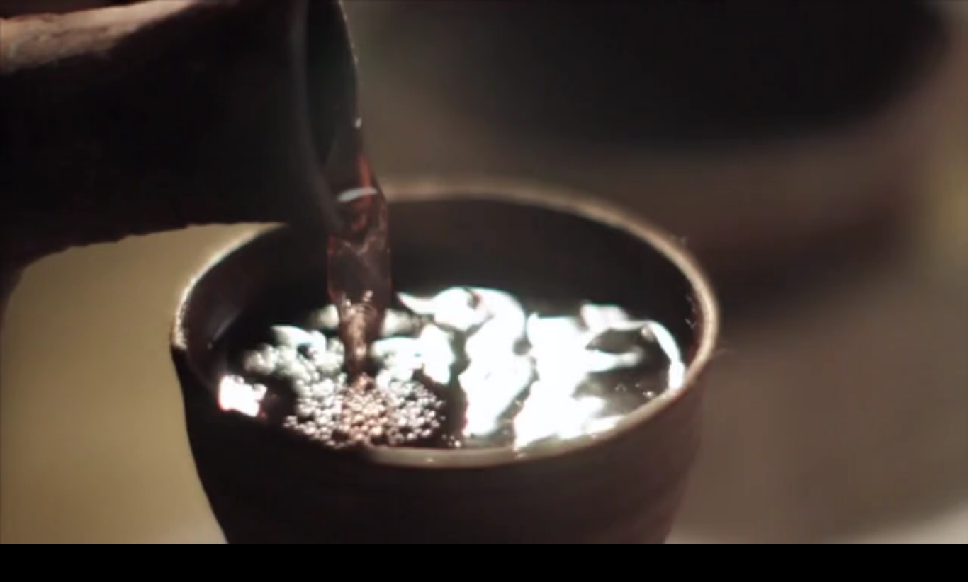
Communion
Questions or Comments?
Click to watch video.

Slide 87
What Is Communion?
It is the Sacrament that gives us the true body and blood of Jesus Christ. His body and blood are joined with the bread and wine.
(Jesus said) “‘This is My body which is for you. Do this in remembrance of Me.’ In the same way also He took the cup, after supper, saying, ‘This cup is the new covenant in My blood. Do this, as often as you drink it, in remembrance of Me.’”
1 Corinthians 11:24b-25

Slide 88
What Is Communion?
How do we know that the four things of the body, blood, bread and wine are present?
The cup of blessing which we bless, is it not the communion of the blood of Christ? The bread which we break, is it not the communion of the body of Christ? 1 Corinthians 10:16

Slide 89
Who Should Receive It?
Communion is not for everyone, all the time. It should be received in faith, repentance and understanding.
“Whoever, therefore, eats the bread or drinks the cup of the Lord in an unworthy manner will be guilty concerning the body and blood of the Lord. Let a person examine himself, then, and so eat of the bread and drink of the cup. For anyone who eats and drinks without discerning the body eats and drinks judgment on himself.” 1 Corinthians 11:27-29

Slide 90
Why Do We Celebrate It?
The chief blessing above all is the forgiveness of sin! With that forgiveness, you know you have life now and forever with God.
(Jesus said)"Drink of it, all of you, for this is My blood of the covenant, which is poured out for many for the forgiveness of sins."
Matthew 26:27b-28

Slide 91
DISCUSSION
Understanding the nature and blessing of Communion, how often do you think you should partake of this Sacrament?
Does an unbeliever also receive the body and blood of Christ?

Slide 92
Session 11

Slide 93
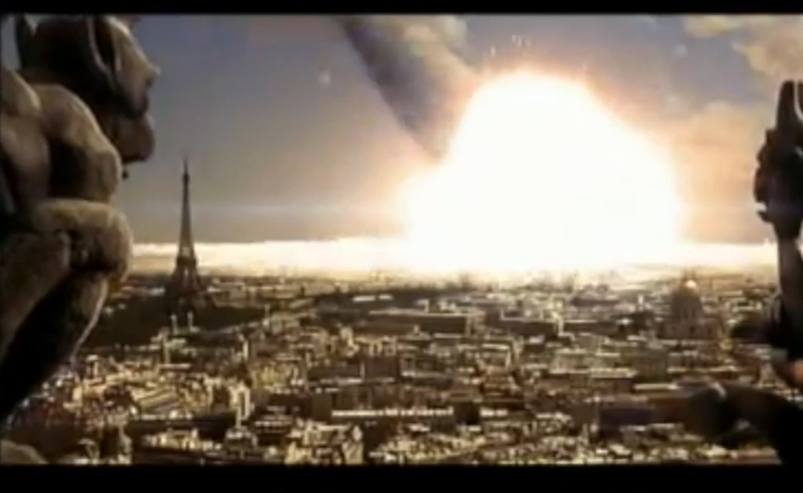
The End of Time
Questions or Comments?
Click to watch video.

Slide 94
How Will It All End?
The world will end at the second coming of Christ; this is called Judgment Day. However, for individuals, one’s eternal fate is determined at the moment his or her death.
"And just as it is appointed for man to die once, and after that comes judgment.”
Hebrews 9:27

Slide 95
What Will Happen to Me?
Believers in Christ will be welcomed to heaven. Unfortunately, unbelievers will be lost to hell.
(Jesus said) “Whoever believes and is baptized will be saved, but whoever does not believe will be condemned.” Mark 16:16

Slide 96
What Will Heaven Be Like?
It is a perfect place of joy in the presence of God that is free from sin forever; it is described with physical characteristics.
“Then I saw a new heaven and a new earth, for the first heaven and the first earth had passed away, and the sea was no more. And I saw the holy city, new Jerusalem, coming down out of heaven from God, prepared as a bride adorned for her husband. And I heard a loud voice from the throne saying, ‘Behold, the dwelling place of God is with man. He will dwell with them, and they will be His people, and God Himself will be with them as their God. He will wipe away every tear from their eyes, and death shall be no more, neither shall there be mourning, nor crying, nor pain anymore, for the former things have passed away.’” Revelation 21:1-4

Slide 97
What Will Hell Be Like?
It is a place of punishment for those who have not believed in Jesus Christ and His forgiveness.
“Then He (God, the King) will say to those on His left, ‘Depart from Me, you cursed, into the eternal fire prepared for the devil and his angels.’”
Matthew 25:41

Slide 98
What Will Happen When Christ Returns?
This present world will be destroyed and then recreated, without sin. All the dead will be brought back to life (resurrected) and judged.
“But according to His promise we are waiting for new heavens and a new earth in which righteousness dwells.” 2 Peter 3:13
“And many of those who sleep in the dust of the earth shall awake, some to everlasting life, and some to shame and everlasting contempt.” Daniel 12:2

Slide 99
When Will the End Come?
No one can predict when the end will come. It will be sudden and unexpected, so we should always be ready.
“But concerning that day and hour no one knows, not even the angels of heaven, nor the Son, but the Father only.”
Matthew 24:36

Slide 100
DISCUSSION
What happens to believers between the time they die and the second coming of Christ?
What is the significance that our bodies will be physically raised back to life on the Last Day?
What are some other opinions you have heard about events at the end of time?

Slide 101
Session 12

Slide 102
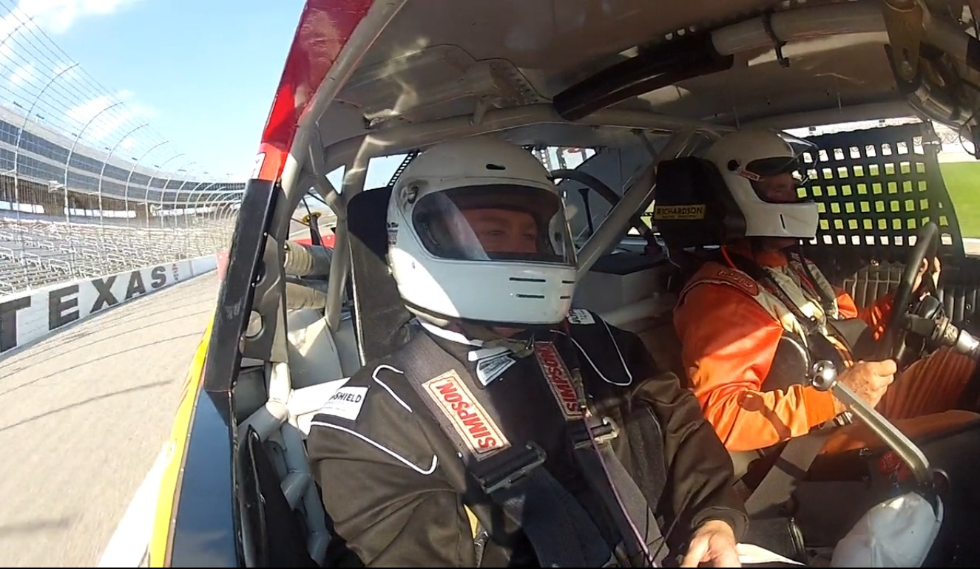
Christian Life
Questions or Comments?
Click to watch video.

Slide 103
What Do I Do Now?
A Christian’s relationship with God is made perfect by grace through faith in Christ. God now calls us to live in love.
And He (Jesus) said to him, “You shall love the Lord your God with all your heart and with all your soul and with all your mind. This is the great and first commandment. And a second is like it: You shall love your neighbor as yourself.”
Matthew 22:37-39

Slide 104
How Do I Love God?
He loves you and enables you to love Him. As we continue in our relationship with Him, we see ways to grow, that is, change!
“Rather, speaking the truth in love, we are to grow up in every way into Him who is the head, into Christ.”
Ephesians 4:15

Slide 105
How Do I Love God?
Gods love is always faithful. We are called to faithfully love God by consistent …
Worship
On Sundays
Pray
Formally
Everyday
Study
Read and study the Bible personally and in groups
And “at all times”

Slide 106
How Do I Love My Neighbor?
Flowing from our love for God, we seek the spiritual and physical well-being of our neighbors.
Service
Meeting needs in the church and world
Outreach
Sharing our faith with those who don’t know
Time
Sharing
Talent
Treasure

Slide 107
DISCUSSION
Who are some people in your life you would like to invite to know God?
As we put God first in our life, what does it look like to trust Him with our finances?
If we are saved by grace through faith, why do we want to do good works?

